Slide 1
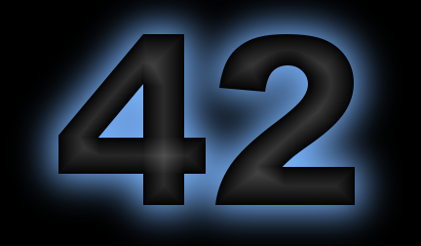
A General-Purpose Multi-body, Multi-spacecraft
Simulation Tool
Eric Stoneking
Code 591

Slide 2
Summary
42 is a comprehensive general-purpose simulation of spacecraft attitude and orbit dynamics.
Its primary purpose is to support design and validation of attitude control systems, from concept studies through integration and test.
42 accurately models multi-body spacecraft attitude dynamics (with rigid and/or flexible bodies), and both two-body and three-body orbital flight regimes, modelling environments from low Earth orbit throughout the solar system.
42 simulates multiple spacecraft concurrently, facilitating studies of rendezvous, proximity operations, and precision formation flying.
42 features visualization of spacecraft attitude.

Slide 3
Features
Multi-body dynamics (tree topology, rotational and/or translational joints)
Rigid and/or flexible bodies
Multiple spacecraft (prox ops, formation flying, or independent)
Inter-spacecraft and spacecraft-surface contact forces support landers, rovers, and spacecraft servicing scenarios
Two-body or three-body orbits, anywhere in the solar system
Optional visualization
Socket-based interprocess comm (IPC) interface to other apps
Fast setup for concept studies
Rigorous and full-featured to support full spacecraft life cycle

Slide 4
42 Supports Distributed Systems
Multiple spacecraft modeled concurrently
Example: 31-spacecraft formation simulated for Stellar Imager Study (2005)
Inter-spacecraft contact forces support docking, servicing scenarios
Common reference orbit preserves numerical accuracy
Example: Sub-nanometer accuracy over 10-km formation for Stellar Imager Study

Slide 5
42 Supports ACS Design in All Phases
Intended for use from concept studies through ops
Rapid prototyping makes it useful for MDL studies
Environment models support actuator sizing, performance studies
High-fidelity dynamics handle multi-body, flexible-body spacecraft
Portability (Mac, linux, Windows) minimizes infrastructure requirements
Clean interface aids progression from flight software “model” to dropping in actual flight software
Interfaces to cFS are under discussion
Visualization aids situational awareness from concept to operations
Designed to be powerful, but easy to get started

Slide 6
42 is Open Source, Portable, Integrable
Released under NOSA in March 2015
sourceforge.net/projects/fortytwospacecraftsimulation
Github/ericstoneking/42
Runs on Mac, linux, Windows
42 is a command-line program
Can be called from other processes (incl. Matlab, python, perl)
Sockets enable Inter-Process Comm
One application runs concurrently with commercial CFD software
Dynamics engine and visualization front end can run as separate processes on separate computers

Slide 7
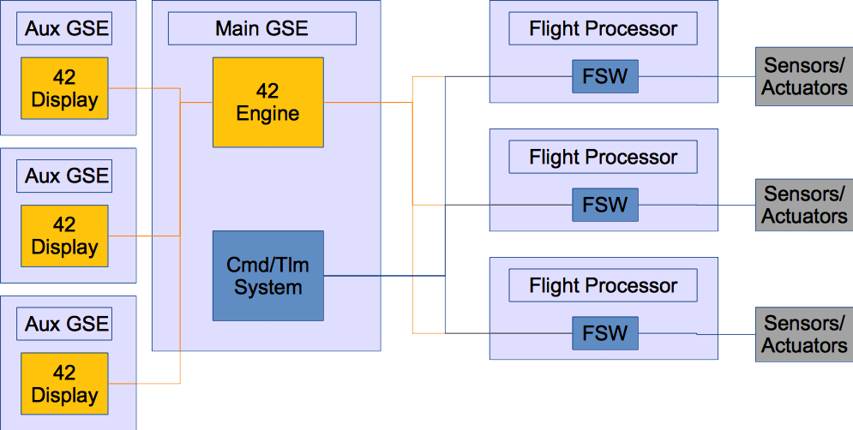
42 as a Multi-spacecraft HWIL Sim
Engine and displays can run on separate computers
Communication by sockets
Engine interfaces with flight processors via cFS over
serial port
(ref Cubesat IRAD, Dellingr)

Slide 8
42 Features a Fleshed-out Solar System
Multiple spacecraft, anywhere in the solar system
Flight regimes include two-body, three-body orbit dynamics, planetary surfaces, comet/asteroid prox ops
One sun, nine planets, 45 major moons
Minor bodies (comets and asteroids) added as needed

Slide 9
42 Dynamics Formulation Preserves Accuracy
Multiple spacecraft may share a reference orbit for formation flying, prox ops
Enables nanometer accuracy with km-scale formations
Kane’s dynamics are efficient, avoid numerical issues that drive performance of Differential-Algebraic-Equation (DAE) formulations
Multiple bodies, each rigid or flexible
Joints support rotation, translation degrees of freedom

Slide 10
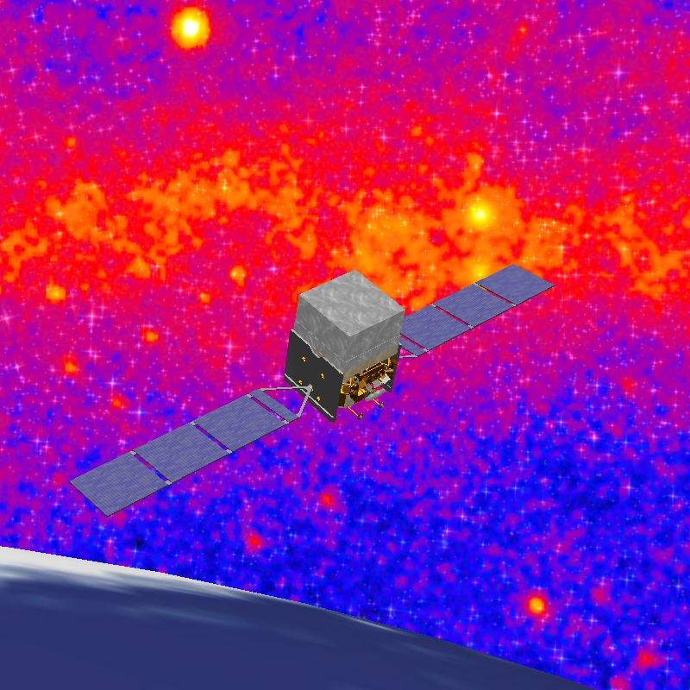
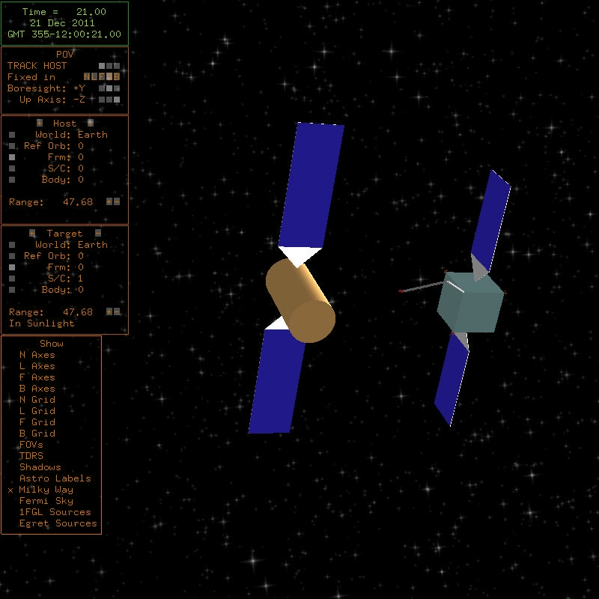
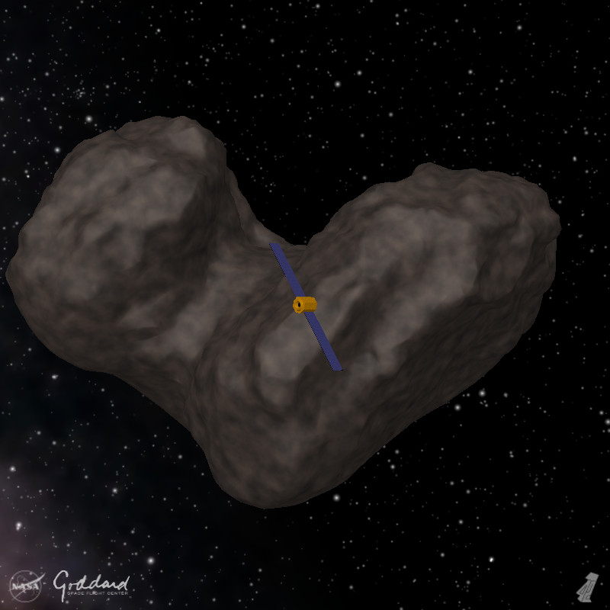
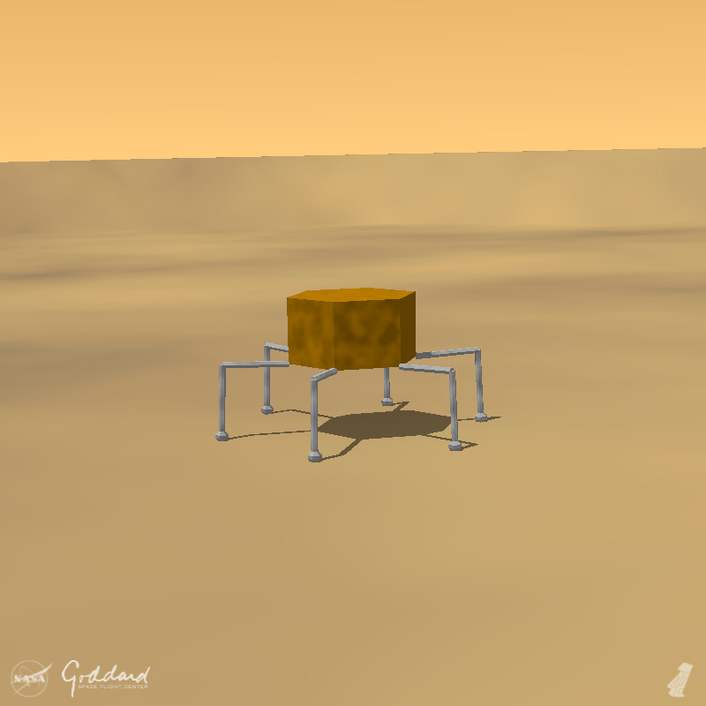
Screenshots
Fermi Gamma-ray
Space Telescope.
Gamma-ray sky
derived from FGST
survey data.
Conceptual rendezvous
and capture scenario
Conceptual spacecraft
in orbit about
Comet 67P-CG
Conceptual hexapod
rover on the surface
of Mars

